Slide 1
Linear Algebra Matrices and Systems of Equations Lecture 3: Matrix Arithmetic
Liang Kong
University of Illinois at Springfield
Notes:
This template can be used as a starter file for presenting training materials in a group setting.
Sections
Sections can help to organize your slides or facilitate collaboration between multiple authors. On the Home tab under Slides, click Section, and then click Add Section.
Notes
Use the Notes pane for delivery notes or to provide additional details for the audience. You can see these notes in Presenter View during your presentation.
Keep in mind the font size (important for accessibility, visibility, videotaping, and online production)
Coordinated colors
Pay particular attention to the graphs, charts, and text boxes.
Consider that attendees will print in black and white or grayscale. Run a test print to make sure your colors work when printed in pure black and white and grayscale.
Graphics, tables, and graphs
Keep it simple: If possible, use consistent, non-distracting styles and colors.
Label all graphs and tables.

Slide 2
Matrix Notation:
Use capital letters denote matrices.
Use denotes each entry.
i: the number of row, j: the number of column.
Notes:
Give a brief overview of the presentation. Describe the major focus of the presentation and why it is important.
Introduce each of the major topics.
To provide a road map for the audience, you can repeat this Overview slide throughout the presentation, highlighting the particular topic you will discuss next.

Slide 3
Vectors
We will refer to an n-tuple of real numbers as a vector.
Column vector
(Column vector can be viewed as n by 1 matrix)
Row vector
(Row vector can be viewed as 1 by n matrix)
Notes:
Give a brief overview of the presentation. Describe the major focus of the presentation and why it is important.
Introduce each of the major topics.
To provide a road map for the audience, you can repeat this Overview slide throughout the presentation, highlighting the particular topic you will discuss next.

Slide 4
Vectors
The set of n by 1 matrices of real numbers is called Euclidean n-space , denoted by
Generally, we omit “column” and refer to the element in as simple vectors.
Notes:
Give a brief overview of the presentation. Describe the major focus of the presentation and why it is important.
Introduce each of the major topics.
To provide a road map for the audience, you can repeat this Overview slide throughout the presentation, highlighting the particular topic you will discuss next.

Slide 5
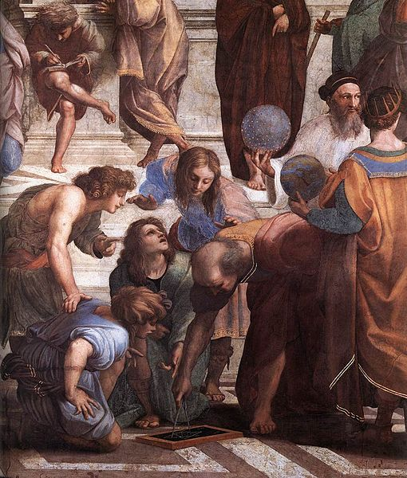
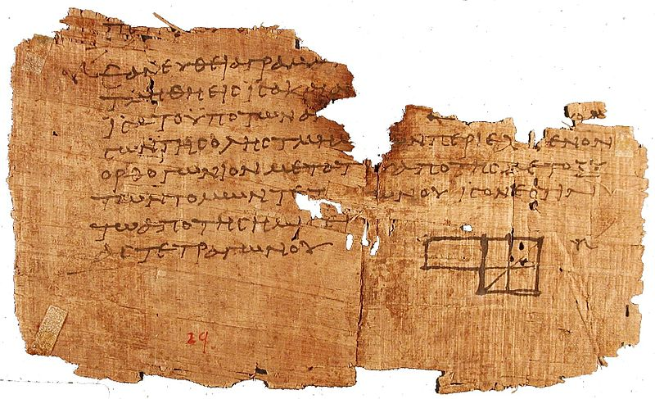
Who is Euclid(Father of geometry)? First math textbook in human history.
Around 300 BC
Elements
Notes:
Give a brief overview of the presentation. Describe the major focus of the presentation and why it is important.
Introduce each of the major topics.
To provide a road map for the audience, you can repeat this Overview slide throughout the presentation, highlighting the particular topic you will discuss next.

Slide 6
Vectors
Any m by n matric can be viewed as
One row of column vectors
One column of row vectors.
Notes:
Give a brief overview of the presentation. Describe the major focus of the presentation and why it is important.
Introduce each of the major topics.
To provide a road map for the audience, you can repeat this Overview slide throughout the presentation, highlighting the particular topic you will discuss next.

Slide 7
Vectors
Example 1: If
Find the row vectors and column vectors of A.
Notes:
Give a brief overview of the presentation. Describe the major focus of the presentation and why it is important.
Introduce each of the major topics.
To provide a road map for the audience, you can repeat this Overview slide throughout the presentation, highlighting the particular topic you will discuss next.

Slide 8
Matrix Arithmetic:
Definition: Two m by n matrices and are said to be equal if for each i and j .
Definition: If A is an m by n matrix and is a scalar, then is the m by n matrix whose (i , j ) entry is . Is called as scalar multiplication.
Definition: Two matrices with same dimension can be added by adding their corresponding entries.
Notes:
Give a brief overview of the presentation. Describe the major focus of the presentation and why it is important.
Introduce each of the major topics.
To provide a road map for the audience, you can repeat this Overview slide throughout the presentation, highlighting the particular topic you will discuss next.

Slide 9
Matrix Multiplication:
Motivation: One equation in several unknowns.
Coefficient vector:
Unknowns vector:
Notes:
Give a brief overview of the presentation. Describe the major focus of the presentation and why it is important.
Introduce each of the major topics.
To provide a road map for the audience, you can repeat this Overview slide throughout the presentation, highlighting the particular topic you will discuss next.

Slide 10
Matrix Equation:
Motivation: One equation in several unknowns.
Define the scalar product as:
The equation can be written as Ax=b, b is a constant.
Notes:
Give a brief overview of the presentation. Describe the major focus of the presentation and why it is important.
Introduce each of the major topics.
To provide a road map for the audience, you can repeat this Overview slide throughout the presentation, highlighting the particular topic you will discuss next.

Slide 11
Matrix Equation:
Motivation: M equation in N unknowns.
It is desirable to write the system as a matrix equation Ax=b.
Notes:
Give a brief overview of the presentation. Describe the major focus of the presentation and why it is important.
Introduce each of the major topics.
To provide a road map for the audience, you can repeat this Overview slide throughout the presentation, highlighting the particular topic you will discuss next.

Slide 12
Matrix Equation:
Example 2:
Example 3: Write the following system as a matrix equation of the form Ax=b.
Notes:
Give a brief overview of the presentation. Describe the major focus of the presentation and why it is important.
Introduce each of the major topics.
To provide a road map for the audience, you can repeat this Overview slide throughout the presentation, highlighting the particular topic you will discuss next.

Slide 13
Matrix Equation:
Alternative representation for ME: M equation in N unknowns.
Thus, we have
Notes:
Give a brief overview of the presentation. Describe the major focus of the presentation and why it is important.
Introduce each of the major topics.
To provide a road map for the audience, you can repeat this Overview slide throughout the presentation, highlighting the particular topic you will discuss next.

Slide 14
Matrix Multiplication:
Example 4: The linear system
can be written as a matrix equations
Notes:
Give a brief overview of the presentation. Describe the major focus of the presentation and why it is important.
Introduce each of the major topics.
To provide a road map for the audience, you can repeat this Overview slide throughout the presentation, highlighting the particular topic you will discuss next.

Slide 15
Two ways to express matrix equation:
Sum of row vectors:
Sum of column vectors:
Notes:
Give a brief overview of the presentation. Describe the major focus of the presentation and why it is important.
Introduce each of the major topics.
To provide a road map for the audience, you can repeat this Overview slide throughout the presentation, highlighting the particular topic you will discuss next.

Slide 16
Linear Combination
Definition: If are vectors in and
are scalars, then the sum of the form
is said to be a linear combination of the vectors
.
Ax is a linear combination of the column vectors of A.
Notes:
Give a brief overview of the presentation. Describe the major focus of the presentation and why it is important.
Introduce each of the major topics.
To provide a road map for the audience, you can repeat this Overview slide throughout the presentation, highlighting the particular topic you will discuss next.

Slide 17
Matrix Multiplication:
Example 5: The linear system
If we choose x₁ =2, x₂ =3 and x₃ =4, then
The system is consistent and the solution is
Notes:
Give a brief overview of the presentation. Describe the major focus of the presentation and why it is important.
Introduce each of the major topics.
To provide a road map for the audience, you can repeat this Overview slide throughout the presentation, highlighting the particular topic you will discuss next.

Slide 18
Matrix Multiplication:
Theorem 1.3.1: A linear system Ax=b is consistent if and only if b can be written as a linear combination of the column vectors of A.
Example 6: Show the linear system is inconsistent.
Notes:
Give a brief overview of the presentation. Describe the major focus of the presentation and why it is important.
Introduce each of the major topics.
To provide a road map for the audience, you can repeat this Overview slide throughout the presentation, highlighting the particular topic you will discuss next.

Slide 19
Matrix Multiplication:
Definition: If A is an m by n matrix and B is an n by r matrix, then the product AB=C is the m by r matrix whose entries are defined by
Where is the i-th row vector of A, is the j-th column vector of B.
Example 7:
Notes:
Give a brief overview of the presentation. Describe the major focus of the presentation and why it is important.
Introduce each of the major topics.
To provide a road map for the audience, you can repeat this Overview slide throughout the presentation, highlighting the particular topic you will discuss next.

Slide 20
Matrix Multiplication:
Example 8: Calculate AB and BA
a)
b)
Notes:
Give a brief overview of the presentation. Describe the major focus of the presentation and why it is important.
Introduce each of the major topics.
To provide a road map for the audience, you can repeat this Overview slide throughout the presentation, highlighting the particular topic you will discuss next.

Slide 21
Transpose of a Matrix
The transpose of A is a n by m matrix, A^T, whose columns are the rows of A.
Notes:
Give a brief overview of the presentation. Describe the major focus of the presentation and why it is important.
Introduce each of the major topics.
To provide a road map for the audience, you can repeat this Overview slide throughout the presentation, highlighting the particular topic you will discuss next.

Slide 22
Matrix Multiplication:
Example 9: Find the transpose of the follow matrices.
a)
b)
Notes:
Give a brief overview of the presentation. Describe the major focus of the presentation and why it is important.
Introduce each of the major topics.
To provide a road map for the audience, you can repeat this Overview slide throughout the presentation, highlighting the particular topic you will discuss next.

Slide 23
Symmetric Matrix
Definition: An n by n square matrix A is said to be symmetric if
Example 10: A matrix A is said to be skew symmetric if A^{T}=-A. Show that if a matrix is skew symmetric, then its diagonal entries must all be zero.
Notes:
Give a brief overview of the presentation. Describe the major focus of the presentation and why it is important.
Introduce each of the major topics.
To provide a road map for the audience, you can repeat this Overview slide throughout the presentation, highlighting the particular topic you will discuss next.

